Slide 1
Software Processes and development life cycle Models
COMP6100001 - Software engineering
Session 02
Kenny Jingga, S.Kom., M.T.

Slide 2
Session 02 - Software Processes and development life cycle Models
Learning objectives
At the end of this session, students will be expected to be able to:
Understand the Purpose and Structure of Software Processes
Explain Key Software Development Life Cycle Models
Compare Different Life Cycle Models for Software Projects
Identify Factors for Selecting an Appropriate Life Cycle Model

Slide 3
Session 02 - Software Processes and development life cycle Models
Content outline
Software processes
SDLC
Waterfall
Iterative & Incremental
Agile overview
Comparison of life cycle models
Selecting appropriate model

Slide 4
Why Software Process Exist?

Slide 5
Introduction to software processes
Software Process
Software Process is a collection of activities, actions, and tasks performed to create a work product (software and its artifacts).
Activity: broad objective (e.g., stakeholder communication, planning, quality assurance)
Action: set of tasks producing a major work product (e.g., architectural design → architecture model)
Task: small, well-defined work producing a tangible outcome (e.g., write unit test, review a user story)
A software process is not rigid, it is an adaptable approach that helps a team select the right work actions and tasks to deliver software on time and with sufficient quality.
Notes:
From Session 1
• Software engineering manages change and complexity
• Process exists because failures are costly

Slide 6
Software Engineering: Principles, practices (technical and non-technical) for confidently building high-quality software.

Slide 7





Introduction to software processes
How to develop software?
“The set of activities and associated results that produce a software product”
Discuss the software that needs to be written
Write some code
Test the code to identify the defects
Debug to find causes of defects
Fix the defects

Slide 8
Introduction to software processes
Software Engineering Practice
Understand the problem
  (communication and analysis)
Plan a solution
  (modeling and software design)
Carry out the plan
  (code generation)
Examine the result for accuracy
  (testing and quality assurance)

Slide 9
Introduction to software processes
Understand the Problem
Who has a stake in the solution to the problem?
  That is, who are the stakeholders?
What are the unknowns?
  What data, functions, and features are required to properly solve the problem?
Can the problem be compartmentalized?
  Is it possible to represent smaller problems that may be easier to understand?
Can the problem be represented graphically?
  Can an analysis model be created?

Slide 10
Introduction to software processes
Plan The Solution
Have you seen similar problems before?
  Are there patterns that are recognizable in a potential solution? Is there existing software that implements the data, functions, and features that are required?
Has a similar problem been solved?
  If so, are elements of the solution reusable?
Can subproblems be defined?
  If so, are solutions readily apparent for the subproblems?
Can you represent a solution in a manner that leads to effective implementation?
  Can a design model be created?

Slide 11
Introduction to software processes
Carry Out The Plan
Does the solution conform to the plan?
  Is source code traceable to the design model?
Is each component part of the solution provably correct?
  Has the design and code been reviewed, or better, have correctness proofs been applied to algorithm?

Slide 12
Introduction to software processes
Examine the Result
Is it possible to test each component part of the solution?
  Has a reasonable testing strategy been implemented?
Does the solution produce results that conform to the data, functions, and features that are required?
  Has the software been validated against all stakeholder requirements?

Slide 13
Introduction to software processes
Software Myths
Beliefs held by managers, customers, and developers
  Example: “If the requirements are written clearly at the beginning, they won’t change.”
Often sound reasonable — but are misleading
  Example: “More documentation means higher software quality.”
Lead to poor decisions in planning and process
  Example: “We can skip testing now and fix bugs later.”
Engineers must challenge myths with evidence
  Example: “Adding more developers will speed up delivery.”
Notes:
“Most project failures don’t start with bad code — they start with bad assumptions.”
Beliefs held by managers, customers, and developers
Example: “If the requirements are written clearly at the beginning, they won’t change.”
“This belief usually comes from non-technical stakeholders.”
Often sound reasonable — but are misleading
Example: “More documentation means higher software quality.”
“Documentation helps — but only if it stays relevant.”
Lead to poor decisions in planning and process
Example: “We can skip testing now and fix bugs later.”
“This myth often pushes teams toward the wrong life cycle model.”
Engineers must challenge myths with evidence
Example: “Adding more developers will speed up delivery.”
“Professional engineers push back using data, not opinions.”

Slide 14
“Good software engineers don’t just write code — they challenge dangerous assumptions.”
SDLC turns belief-based development into evidence-based development
Notes:
Software myths lead to poor decisions
Poor decisions cause late failures and rework
SDLC exists to replace assumptions with structure

Slide 15
Introduction to software processes
Software Development Life Cycle (SDLC)
Planning
Analysis
Design
Implementation
Testing & Integration
Deployment
Maintenance
A structured and systematic approach to the development, deployment, and maintenance of software applications
Ensure software projects are well-managed, user-centered, and produce high-quality outcomes
Software Development Life Cycle (SDLC) Phases
Notes:
Others Explanation:
A framework that guides the process of creating software from its conceptualization to its eventual retirement
Outlines a series of well-defined phases, activities, and deliverables that help ensure the successful creation of high-quality software that meets user needs and business requirements

Slide 16
Introduction to software processes
SDLC Phases
Planning → defining project scope, goals, resources, and timelines
Analysis → understanding user needs, requirements, and feasibility assessment
Design → creating a blueprint for the software’s structure and functionality
Implementation → writing the actual code and translating design into functional software
Testing & Integration → rigorous testing to ensure the software works as intended, followed by seamless integration of different components
Deployment → releasing the software to users after thorough testing and approval
Maintenance → ongoing care, updates, and improvements to keep the software reliable and relevant

Slide 17
Introduction to software processes
The importance of SDLC
Structured Approach → systematic approach to ensure that each phase is well-defined and executed in a logical sequence
Clarity and Communication → documenting requirements, designs, and processes enhances communication among team members, stakeholders, and users
Risk Management → identify potential risks early in the process
Quality Assurance → rigorous testing and integration phases ensure that the software meets quality standards and functions as expected
User Satisfaction → focus on understanding user needs and aligning software development with those needs
Efficiency → reduce rework, minimize errors, and improve overall efficiency in software development
Documentation → produce documentation at each phase, which become a valuable resource for training, maintenance, and future enhancements

Slide 18
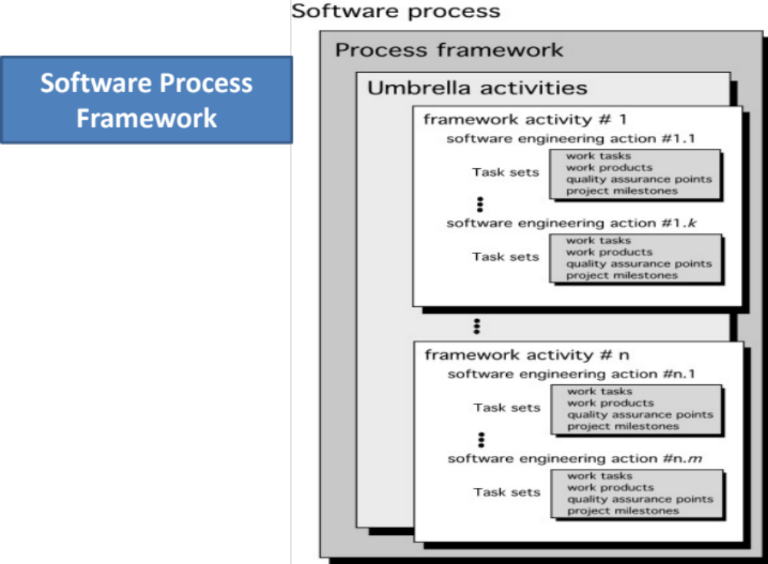
Introduction to software processes
Software Process Structure

Slide 19
Introduction to software processes
Framework Activities
Communication
Planning
Modeling
  Analysis of requirements
  Design
Construction
  Code generation
  Testing
Deployment

Slide 20
Introduction to software processes
Umbrella Activities
Software project tracking and control
Risk management
Software quality assurance
Technical reviews
Measurement
Software configuration management
Reusability management
Work product preparation and production

Slide 21
“How should engineers think and behave?”

Slide 22
Introduction to software processes
Hooker’s General Principle
1: The Reason It All Exists
2: KISS (Keep It Simple, Stupid!)
3: Maintain the Vision
4: What You Produce, Others Will Consume
5: Be Open to the Future
6: Plan Ahead for Reuse
7: Think!

Slide 23
Engineering principles must be reflected in how work flows.
Notes:
“Hooker tells us how engineers should think.
Process flow shows how that thinking is organized into work.”

Slide 24
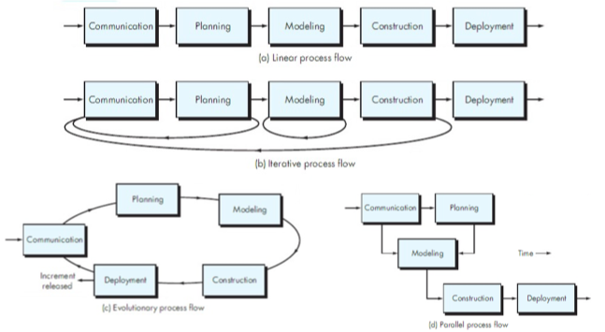
Introduction to software processes
Process Flow
Notes:
Linear — activities executed once, in order
Iterative — activities revisited through cycles
Evolutionary — system grows through increments
Parallel — activities overlap to reduce time
“Same activities, different flow — and that choice matters.”

Slide 25
Introduction to software processes
Software Process Models
Process models describe how SDLC activities are structured
All models use the same basic phases
Models differ in order, feedback, and control
Notes:
Descriptive representation of the SDLC, different approach but the basic phases and activity remain the same for all the models
Prescriptive process models advocate an orderly approach to software engineering
That leads to a few questions …
If prescriptive process models strive for structure and order, are they inappropriate for a software world that thrives on change?
Yet, if we reject traditional process models (and the order they imply) and replace them with something less structured, do we make it impossible to achieve coordination and coherence in software work?

Slide 26
Different models balance structure and change differently
Notes:
Should software development prioritize order or adaptability?
How much structure is needed to ensure coordination and quality?

Slide 27
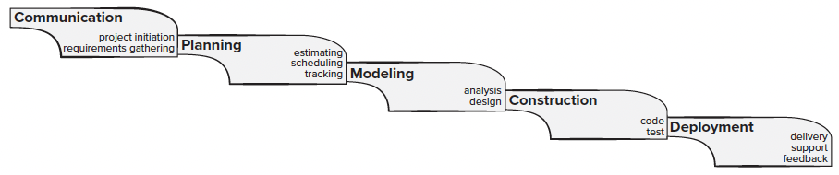
Waterfall Model: Phases and Limitations
Concepts
The Waterfall Model is one of the earliest and most traditional software development life cycle (SDLC) models. It follows a linear and sequential approach where each phase must be completed before the next begins.

Slide 28
Waterfall Model: Phases and Limitations
Advantages and Limitations
Advantages:
Clear structure and milestones
Easy to manage and track progress
Suitable for stable requirements
Limitations:
Difficult to accommodate change
Testing and feedback occur late
High risk if early assumptions are wrong.

Slide 29
Waterfall Model: Phases and Limitations
When To Use
Projects with Well-understood Requirements: When requirements are clear and unlikely to change.
Short Projects: With a short development time frame.

Slide 30
Iterative and incremental development
Concepts
Iterative and Incremental Development (IID) combines iterative design with incremental builds. It allows for repeated cycles (iterations) and gradual development (increments), enabling feedback and adaptation throughout the development process.
Iteration: Developing a system through repeated cycles, refining it with each pass
Increment: Building the system piece by piece, adding functionality in each increment

Slide 31
Iterative and incremental development
Advantages and Limitations
Advantages:
Early user feedback
Risks identified earlier
Partial functionality delivered sooner
Limitations
Requires frequent planning and review
More complex coordination
Scope may expand without discipline

Slide 32
Iterative and incremental development
Variants of Iterative Development
Different implementations of the same iterative idea:
Prototyping Model
Evolutionary Model
Unified Process

Slide 33
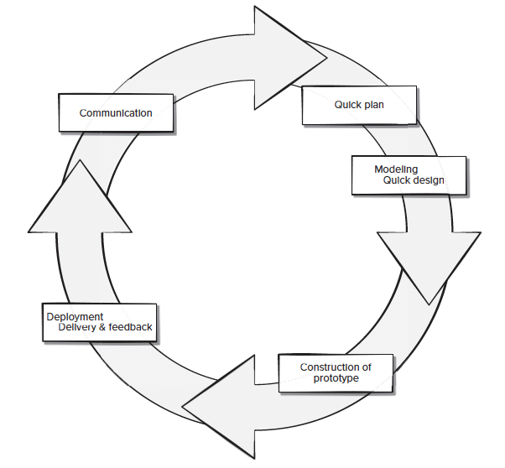
Iterative and incremental development
Prototyping process Model

Slide 34
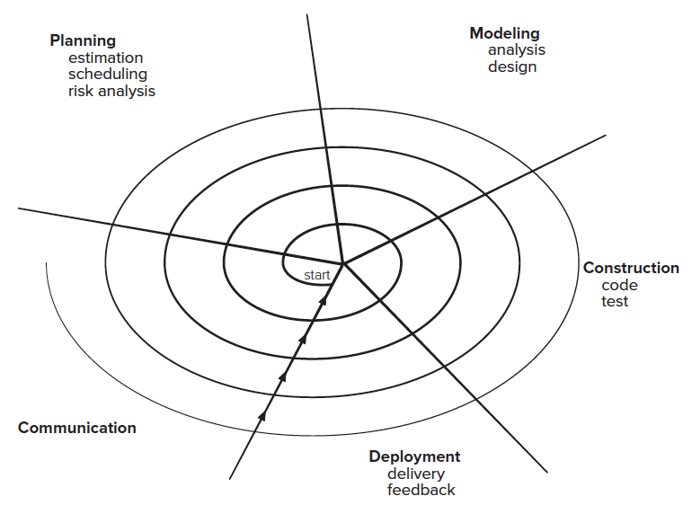
Iterative and incremental development
Evolutionary Process Model

Slide 35
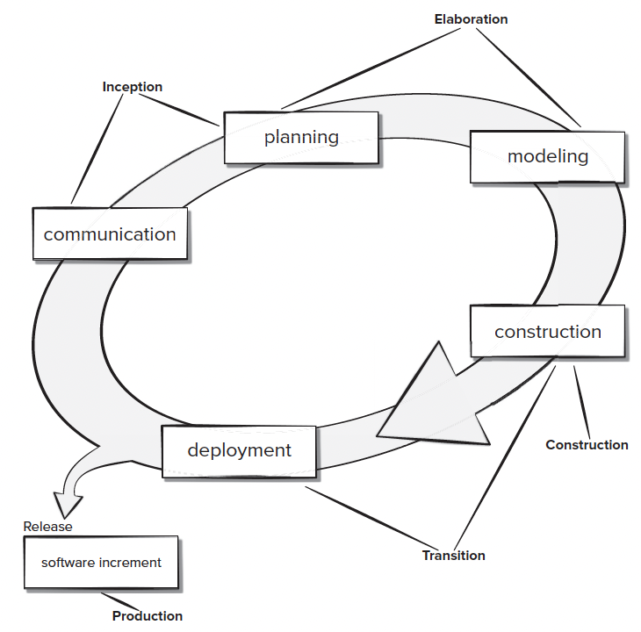
Iterative and incremental development
The Unified Process

Slide 36
Iterative and incremental development
When To Use
Complex Projects: Where requirements are not fully understood from the beginning.
Projects Requiring Flexibility: When changes are expected during development.

Slide 37
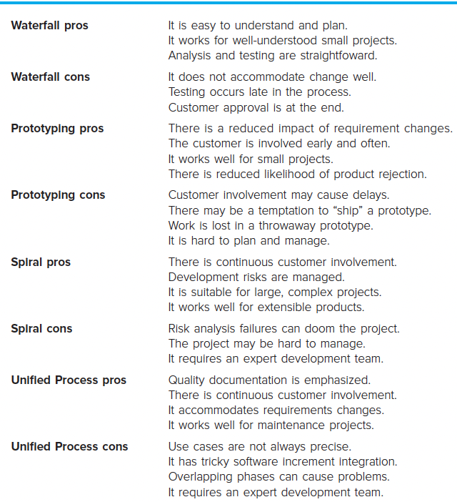
Waterfall and iterative and incremental development
PROS and CONS
Dimension | Waterfall | Prototyping | Spiral | Unified Process
Requirement change | Poor | Good | Good | Good
Customer involvement | Low | High | High | High
Risk management | Low | Medium | High | Medium
Planning & control | High | Low | Medium | Medium
Project size suitability | Small | Small–Medium | Large & complex | Medium–Large
Team expertise needed | Low | Medium | High | High

Slide 38
From Iterative Models to Agile
Several SDLC models are iterative and incremental
These models differ in how they manage risk, feedback, and control
Agile belongs to this family — but emphasizes adaptability more strongly
Agile takes iterative and incremental development and optimizes it for continuous change

Slide 39
Agile methodologies overview
Concepts
Agile as a Life Cycle Model:
Iterative and incremental
Adaptive planning
Frequent customer feedback
Change is expected throughout development
Agile methodologies emphasize flexibility, customer collaboration, and responding to change. They focus on delivering small, functional pieces of software quickly and iteratively.

Slide 40
Agile methodologies overview
Benefits and Challenges
Benefits:
Customer Satisfaction: Regular delivery of valuable software.
Adaptability: Quick response to change.
Transparency: Continuous stakeholder involvement.
Improved Quality: Frequent testing and feedback loops.
Challenges:
Requires Cultural Shift: Teams must embrace collaboration and flexibility.
Less Predictability: Planning can be more complex due to changing requirements.
Documentation May Suffer: Emphasis on working software can lead to insufficient documentation.

Slide 41
Comparison of Different Life Cycle Models
Factors to Consider
Project Size and Complexity
Requirement Stability
Risk Levels
Customer Involvement
Time Constraints

Slide 42
Comparison of Different Life Cycle Models
The comparison
Aspect | Waterfall Model | Iterative & Incremental | Agile Methodologies
Process Flow | Linear and Sequential | Cyclical with Repeated Phases | Iterative with Frequent Releases
Flexibility to Changes | Low | Medium | High
Customer Involvement | Limited to Requirement Phase | Regular Feedback | Continuous Collaboration
Documentation | Extensive | Moderate | Minimal, Focus on Working Software
Risk Management | Risk Identification Late in the Process | Early Risk Identification and Mitigation | Risks Managed Throughout with Adaptability
Delivery | Single Delivery at End | Incremental Deliveries | Continuous Delivery of Small Increments
Best Suited For | Projects with Stable Requirements | Complex Projects, Where Requirements Evolve Over Time | Dynamic Projects with Rapidly Changing Requirements
Examples | Government Projects, Safety-Critical Systems | Large Systems, Enterprise Applications | Web Applications, Start-ups, Customer-Centric Products
Trade-offs: Understanding that no one model fits all projects.
Hybrid Approaches: Combining elements from different models to suit specific project needs.

Slide 43
Human Aspects of Software Engineering
Characteristics of Software Engineer
Seven traits that are present when an individual software engineer exhibits “superprofesional” behavior.
An effective software engineer :
  has a sense of individual responsibility
  has an acute awareness
  is brutally honest
  exhibits resilience under prerssure
  has a heightened sense of fairness
  exhibits attention to detail
  is pragmatic

Slide 44
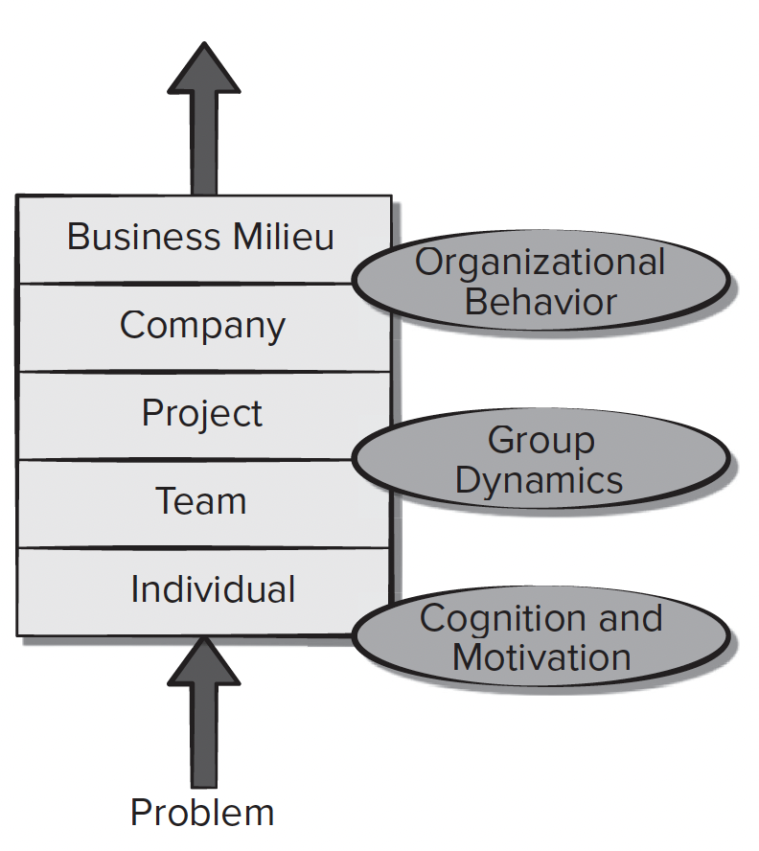
Human Aspects of Software Engineering
The Psychology of Software Engineering
Layered behavioral model for software development

Slide 45
Human Aspects of Software Engineering
The Software Team
An effective team should foster a sense of trust
Software engineers on the team should trust the skills and competence of their peers and their managers.
The team should encourage a sense of improvement by periodically reflecting on its approach to software engineering and looking for ways to improve their work

Slide 46
Human Aspects of Software Engineering
Team Structure
Four “organizational paradigms” for software engineering teams:
A closed paradigm
  a team along a traditional hierarchy of authority
A random paradigm
  a team loosely and depends on individual initiative of the team members
An open paradigm
  a team in a manner that achieves some of the controls associated with the closed paradigm but also much of the innovation that occurs when using the random paradigm
A synchronous paradigm
  relies on the natural compartmentalization of a problem and organizes team members to work on pieces of the problem with little active communication among themselves

Slide 47
Selecting the Appropriate Life Cycle Model for a Project
Decision matrix example
Factor | Waterfall | Iterative & Incremental | Agile
Requirement Stability | High | Medium | Low
Customer Availability | Low | Medium | High
Risk Level | Low | Medium to High | High
Project Complexity | Low to Medium | High | Medium
Time to Market | Flexible | Moderate | Critical
Team Expertise | Moderate | High | High
Notes:
Project Requirements
Stability: Are the requirements well-understood and unlikely to change?
Clarity: Are the requirements clear or ambiguous?
Customer Involvement
Availability: Is the customer available for continuous collaboration?
Feedback Importance: How critical is customer feedback during development?
Risk Assessment
Technological Risks: New or unproven technologies may require flexibility.
Market Risks: Projects in fast-moving markets may need Agile responsiveness.
Project Size and Complexity
Small vs. Large Teams: Different models suit different team sizes.
Complexity Levels: Complex projects may benefit from iterative approaches.
Time to Market
Urgency: Is there a need for rapid delivery?
Competition: Does the project need to adapt quickly to competitive pressures?
Team Expertise
Experience with Methodologies: Teams familiar with Agile may perform better using it.
Skill Levels: Highly skilled teams may handle flexible models more effectively.

Slide 48
References
Titus Winters, Tom Manshreck, and Hyrum Wright. (2020). Software Engineering at Google: Lesson Learned from Programming Over Time. 1st. O’Reilly Media. California. ISBN: 978-1492082798.
Roger Pressman and Bruce Maxim. (2020). Software Engineering: A Practitioner's Approach. 9th E. McGraw- Hill. New York. ISBN: 9781259872976.
Multimedia : Video Water Fall, V model, http://www.youtube.com/watch?v=KaPC0gsEQ68
Software Engineering Incremental Model, http://www.youtube.com/watch?v=9cBkihYP1rY

